Slide 1



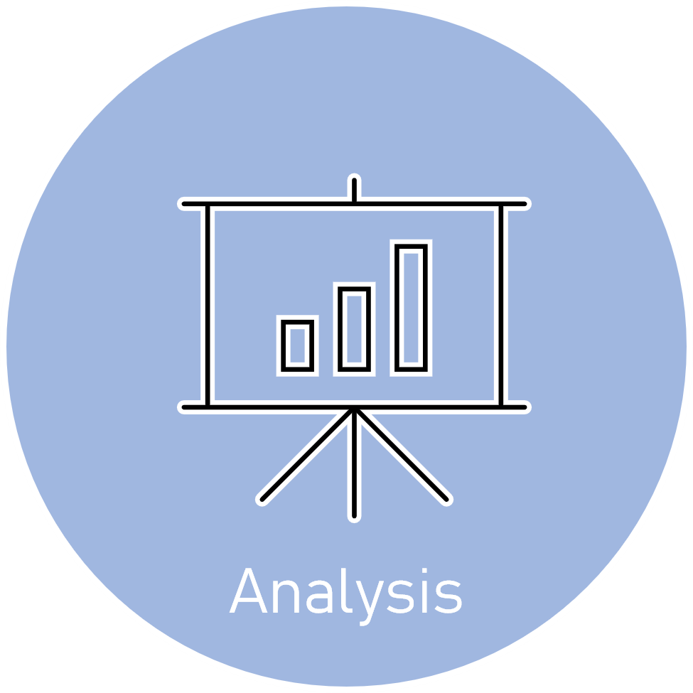


Slide 2



Data
Preparation
Developer Survey is collected from over 80K respondents throughout 2019

Slide 3
Data
Preparation
Developer Survey is collected from over 80K respondents throughout 2019

Slide 4

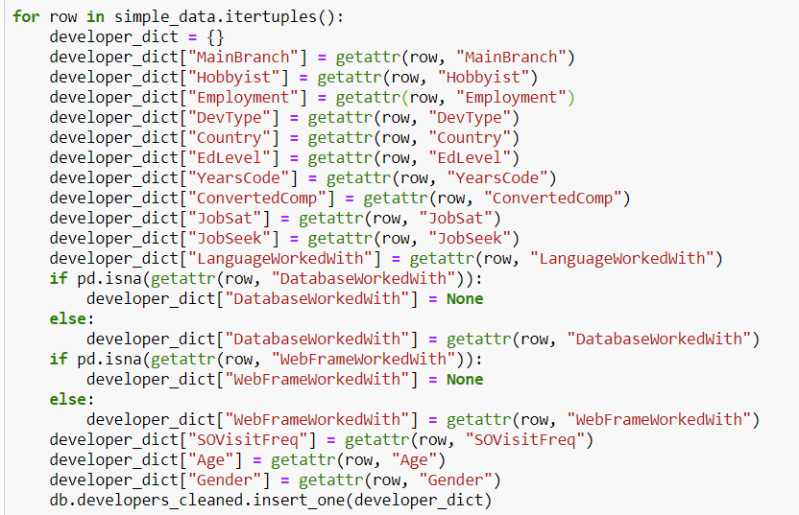
Data
Cleaning
&
MongoDB

Slide 5
Data
Cleaning
&
MongoDB
The dataset was very clean and had lots of information that can be used for different types of analysis

Slide 6



CODING

Slide 7
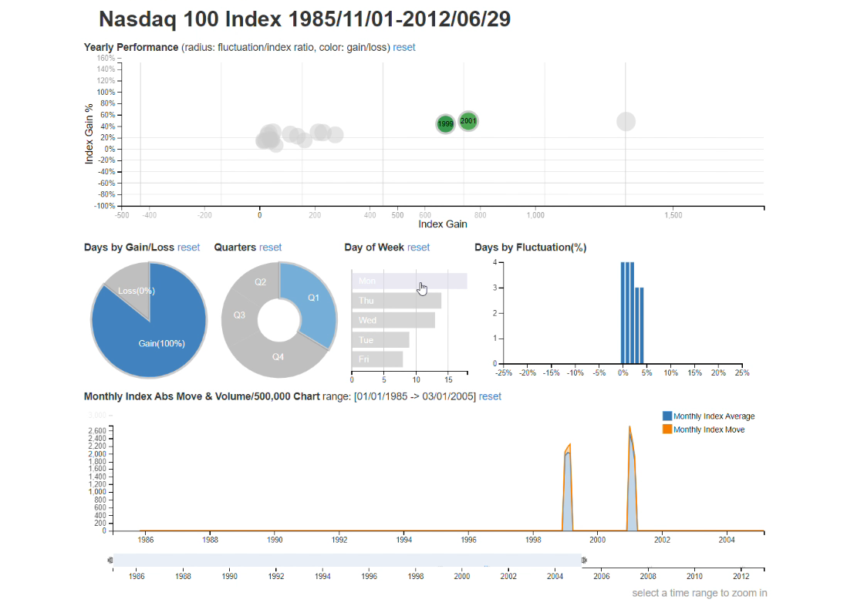
Why?
The project exploited DC.js
Library of Javascript for its
ability to work efficiently with large dimensional datasets and its native support of Crossfilter.

Slide 8
Pros
Great data visualization.
Performs graphical filtering.
Fast creation of charts and dashboards.
Creation of highly interactive dashboards.
Cons
Extremely buggy.
Lots of workarounds even for the simplest tasks.
Many conflicting solutions.

Slide 9
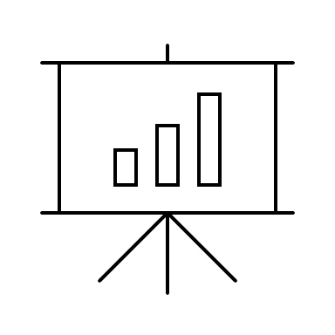


Analysis

Slide 10
What?
The project aimed at building interactive charts showing relationship between Development Type, Programming Languages used, Compensation of respondents converted to USD and the Job satisfaction.

Slide 11
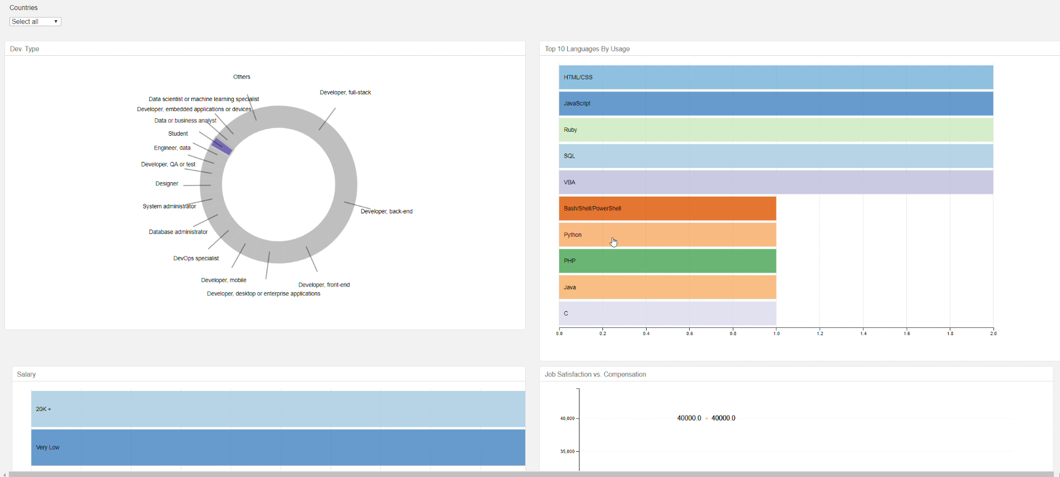
Results?
The resulted tool is visually pleasant and easy to use. By just clicking on the specific parts of the charts the user can get idea on which languages are most popular in a specific domain and most common compensations. Information about job satisfaction relative to the compensation is made available to user in a boxplot chart. All this can be filtered by country which is available to user as drop-down menu.

